Slide 1
Unit I – Basics of Computer Network

Slide 2
Contents
Definition of Computer Network
Goals of Computer Network: For Businesses, For People
Advantages & Disadvantages of Computer Network
Applications of Computer Network
Components of Computer Network
Types of Networks
Network Topologies.

Slide 3
What is computer network?
A network is interconnection of set of devices capable of communication.
A device can be anything like a desktop computer, laptop, phone, tablets, smart watch and other smart devices.
These devices are called hosts.
Devices connecting two hosts (network devices) are also included in networking devices. E.g. a switch, modem, router etc..

Slide 4
Contents
Definition of Computer Network
Goals of Computer Network: For Businesses, For People
Advantages & Disadvantages of Computer Network
Applications of Computer Network
Components of Computer Network
Types of Networks
Network Topologies.

Slide 5
Goals of Computer Network: For Businesses, For People
Internet Connectivity
Peer-to-peer communication
Instant messaging
Social networking
IPTV

Slide 6
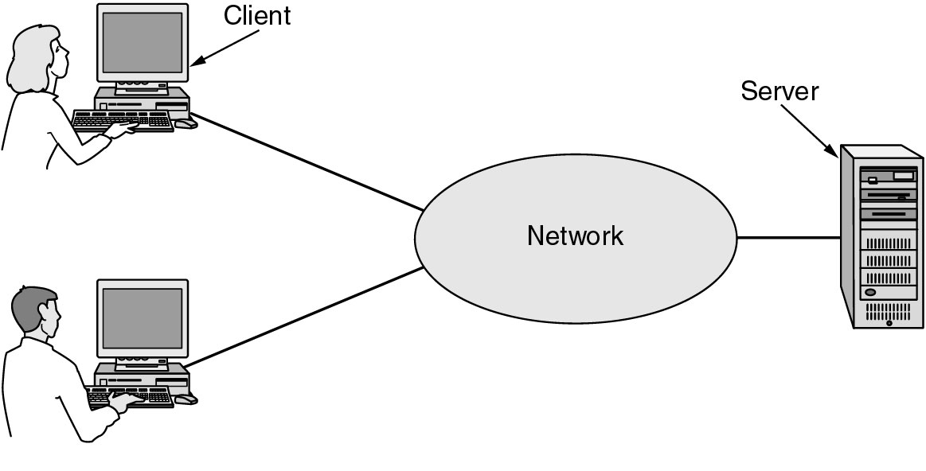
Goals of Computer Network: For Businesses, For People
Resource Sharing
VPN
IP telephony – Voice over IP (VOID)
Desktop sharing
A network with two clients and one server.

Slide 7
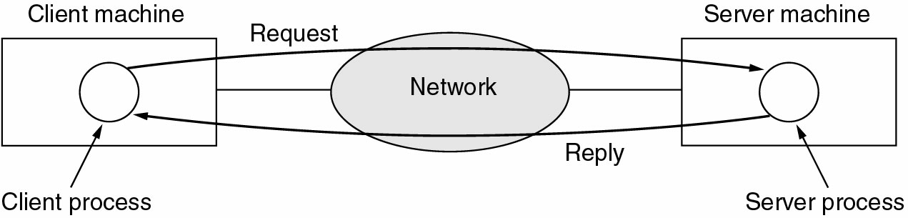
Goals of Computer Network: For Businesses, For People
The client-server model involves requests and replies.

Slide 8
Contents
Definition of Computer Network
Goals of Computer Network: For Businesses, For People
Advantages & Disadvantages of Computer Network
Applications of Computer Network
Components of Computer Network
Types of Networks
Network Topologies.

Slide 9
Advantages & Disadvantages of Computer Network
Advantages
File sharing: network offer a quick and easy way to share files.
Security : Specific directories can be password protected to limit access to authorized users. Unauthorized person cannot access the data.
Resource sharing: all computer network can share resources such as printer, fax, modems and scanners.
Communication: User on network can communicate with each other via electronic mail over network system. When user connect with internet , network user communicate all around word via the network.

Slide 10
Advantages & Disadvantages of Computer Network
Disadvantages
Expensive to install
Administrator Time Requirement
File server Failures
Broken cables

Slide 11
Contents
Definition of Computer Network
Goals of Computer Network: For Businesses, For People
Advantages & Disadvantages of Computer Network
Applications of Computer Network
Components of Computer Network
Types of Networks
Network Topologies.

Slide 12
Applications of Computer Network
E-mail
Searchable Data (Web Sites)
E-Commerce
News Groups
Internet Telephony (VoIP)
Video Conferencing
Chat Groups
Instant Messengers
Internet Radio

Slide 13
Contents
Definition of Computer Network
Goals of Computer Network: For Businesses, For People
Advantages & Disadvantages of Computer Network
Applications of Computer Network
Components of Computer Network
Types of Networks
Network Topologies.

Slide 14
Components of Computer Network
Message
Sender
Receiver
Medium
Protocols

Slide 15
Contents
Definition of Computer Network
Goals of Computer Network: For Businesses, For People
Advantages & Disadvantages of Computer Network
Applications of Computer Network
Components of Computer Network
Types of Networks
Network Topologies.

Slide 16
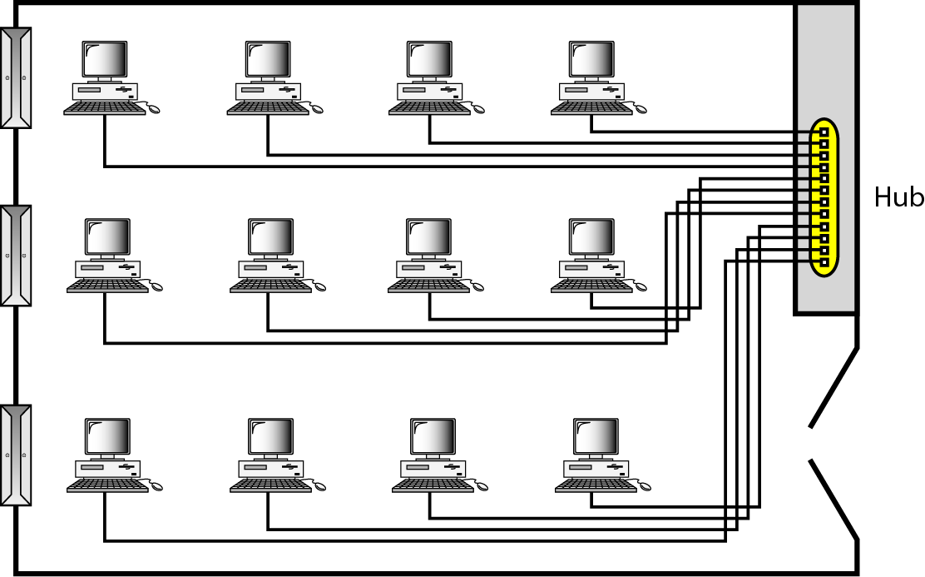
Types of Networks
Local Area Network (LAN)
Privately owned
Links devices in the same office, building, or campus
Simple LAN: 2 PCs & 1 printer in home or office
Size is limited to a few kilometers
Allow resources to be shared (hardware, software, or data)

Slide 17
Types of Networks
Local Area Network (LAN)
LAN is distinguished by:
Size (# users of OS, or licensing restrictions)
Transmission medium (only one type)
Topology (bus, ring, star)
Data Rates (speed):
Early: 4 to 16 Mbps
Today: 100 to 1000 Mbps

Slide 18
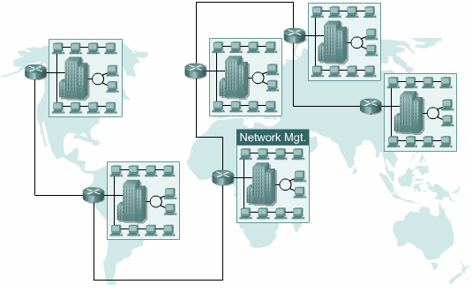
Types of Networks
Wide Area Networks (WAN)
Provides long-distance transmission of data over large geographic areas (country, continent, world)

Slide 19
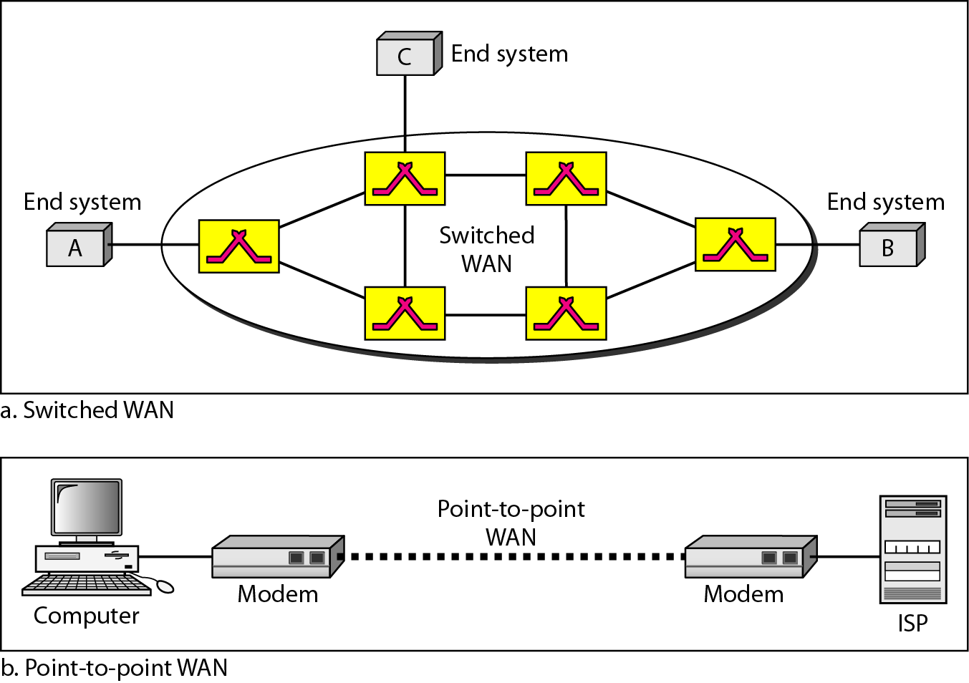
Types of Networks
Wide Area Networks (WAN)
Switched WAN
Backbone of the Internet
Dialup line point-to-point WAN
Leased line from a telephone company

Slide 20
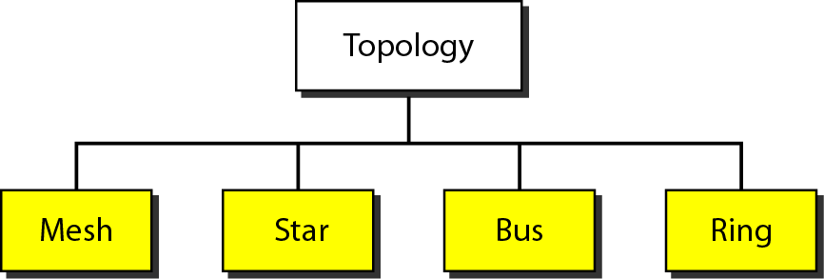
Types of Networks
Metropolitan Area Networks (MAN)
Size between LAN and WAN
Inside a town or a city
Example: the part of the telephone company network that can provide a high-speed DSL to the customer

Slide 21
Contents
Definition of Computer Network
Goals of Computer Network: For Businesses, For People
Advantages & Disadvantages of Computer Network
Applications of Computer Network
Components of Computer Network
Types of Networks
Network Topologies.

Slide 22
Network Topologies
The way a network is laid out physically
Two or more links form a topology
The topology of a network is the geometric representation of the relationship of all the links and linking devices (nodes) to one another.
Four topologies : Mesh, Star, Bus, and Ring

Slide 23
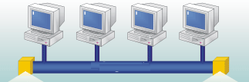
Network Topologies
Bus
It is multipoint
One long cable acts as a backbone
Used in the design of early LANS, and Ethernet LANs

Slide 24
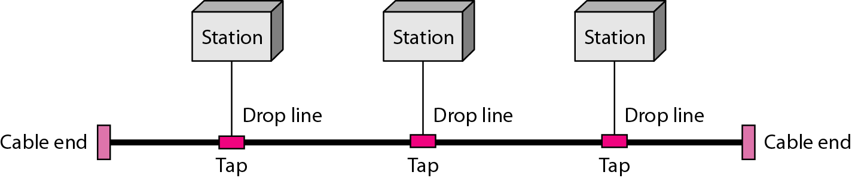
Network Topologies
Bus
Nodes connect to cable by drop lines and taps
Signal travels along the backbone and some of its energy is transformed to heat
Limit of number of taps and the distance between taps

Slide 25

Network Topologies
Bus
Advantages
Ease of installation
Less cables than mesh, star topologies
Disadvantages
Difficult reconnection and fault isolation ( limit of taps)
Adding new device requires modification of backbone
Fault or break stops all transmission
The damaged area reflects signals back in the direction of the origin, creating noise in both directions

Slide 26
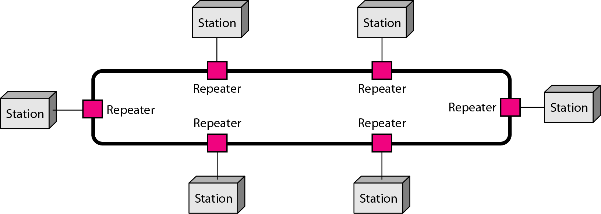
Network Topologies
Ring
Each device has dedicated point-to-point connection with only the two devices on either side of it
A signal is passed along the ring in one direction from device to device until it reaches its destination
Each devices incorporates a Repeater

Slide 27
Network Topologies
Ring
Advantages
Easy of install and reconfigure
Connect to immediate neighbors
Move two connections for any moving (Add/Delete)
Easy of fault isolation
Disadvantage
Unidirectional
One broken device can disable the entire network. This weakness can be solved by using a dual ring or a switch capable of closing off the break

Slide 28
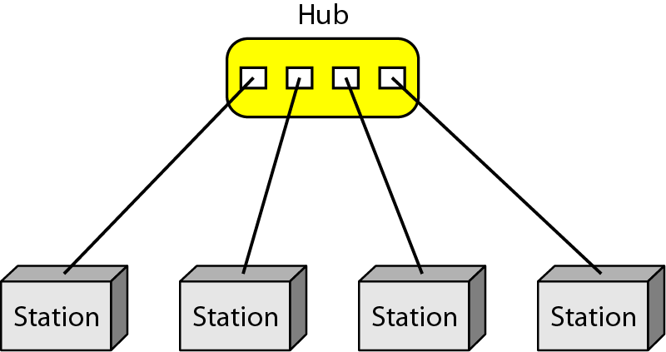
Network Topologies
Star:
Dedicated point-to-point to a central controller (Hub)
No direct traffic between devices
The control acts as an exchange

Slide 29
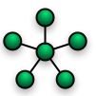
Network Topologies
Star
Advantages
Less expensive than mesh (1 Link + 1 port per device)
Easy to install and reconfigure
Less cabling
Additions, moves, and deletions required one connection
Robustness : one fail does not affect others
Easy fault identification and fault isolation

Slide 30
Network Topologies
Star
Disadvantages
Dependency of the whole topology on one single point (hub)
More cabling than other topologies ( ring or bus)
Used in LAN

Slide 31
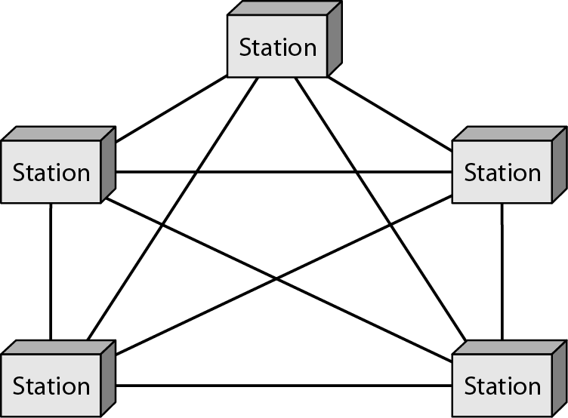
Network Topologies
Mesh
Every link is dedicated point-to-point link
The term dedicated means that the link carries traffic only between the two devices it connects

Slide 32
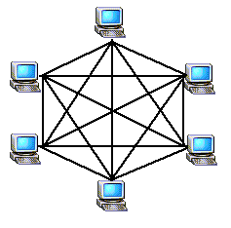
Network Topologies
Mesh
To link n devices fully connected mesh has: n ( n - 1) / 2 physical channels (Full-Duplex)
Every Device on the network must have n - 1 ports

Slide 33

Network Topologies
Mesh
Advantages
Each connection carry its own data load (no traffic problems)
A mesh topology is robust
Privacy or security
Fault identification and fault isolation

Slide 34
Network Topologies
Mesh:
Disadvantages
Big amount of cabling
Big number of I/O ports
Installation and reconnection are difficult
Sheer bulk of the wiring can be greater than the available space
Hardware connect to each I/O could be expensive
Mesh topology is implemented in a limited fashion; e.g., as backbone of hybrid network

Slide 35
Network Topologies
Hybrid Topology
Example: having a main star topology with each branch connecting several stations in a bus topology

Slide 36
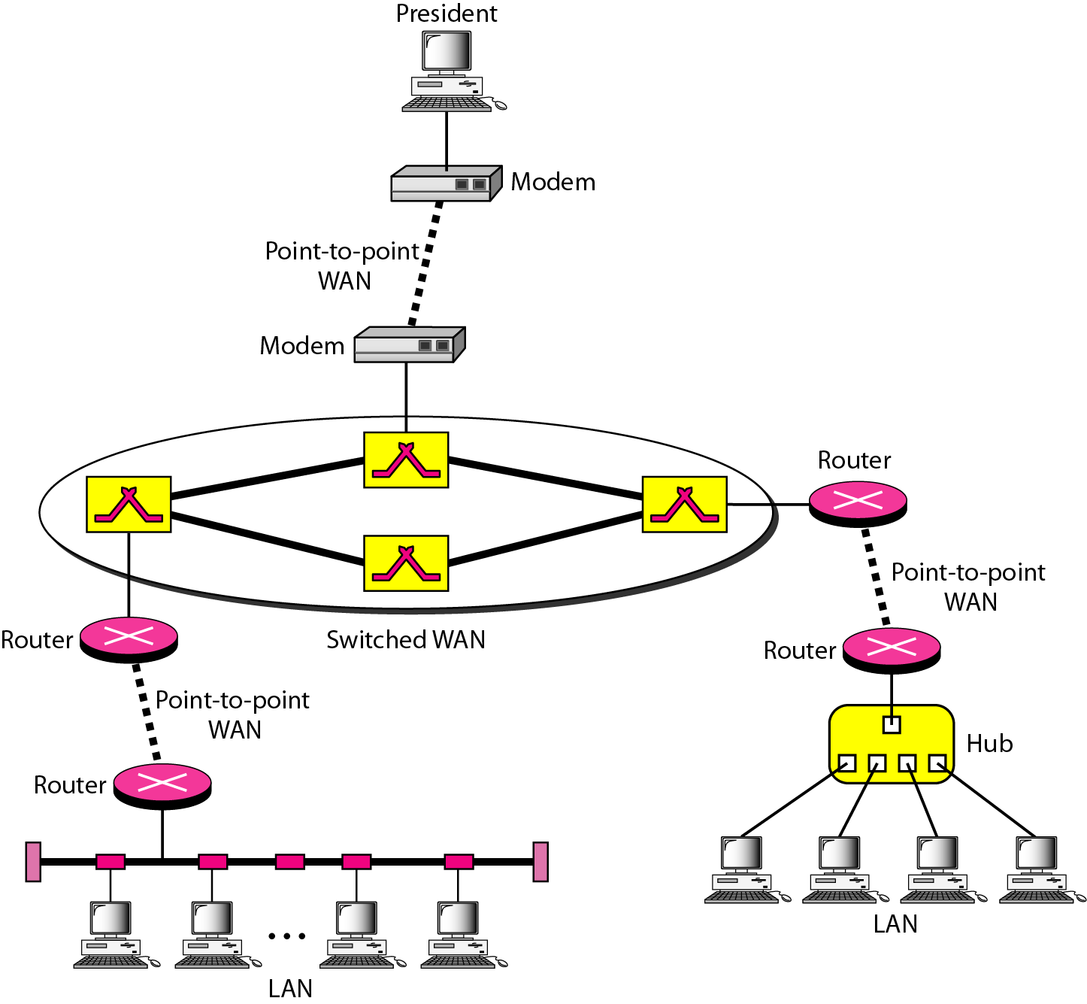
Interconnection of Networks: Internetworks
Interconnection of Networks: Internetworks

